Slide 1
LIBRARY MANGAMENT SYSTEM
Group Number 6
Chandrika Pentela
Sakshi Chaturvedi
Triveni Gorantla
Harini Patibandla

Slide 2
Requirement Understanding
The users are classified into four types:
User-can Login
Librarian-can do Insert/Update/Delete/Search/Add Books

Slide 3
Modules
Login
Home Page
Search Book
Delete Book
Add Book
Update Book
Display Book

Slide 4
Modules
Login Module:
Login module is common for all the users of the system i.e. User, Librarian and Student.
Basic functionality of module are as follows:
Taking login credentials from the user.
If given credentials are wrong, show appropriate message.
If login succeeds, user will be navigated to his/her respective page as per his/her role.

Slide 5
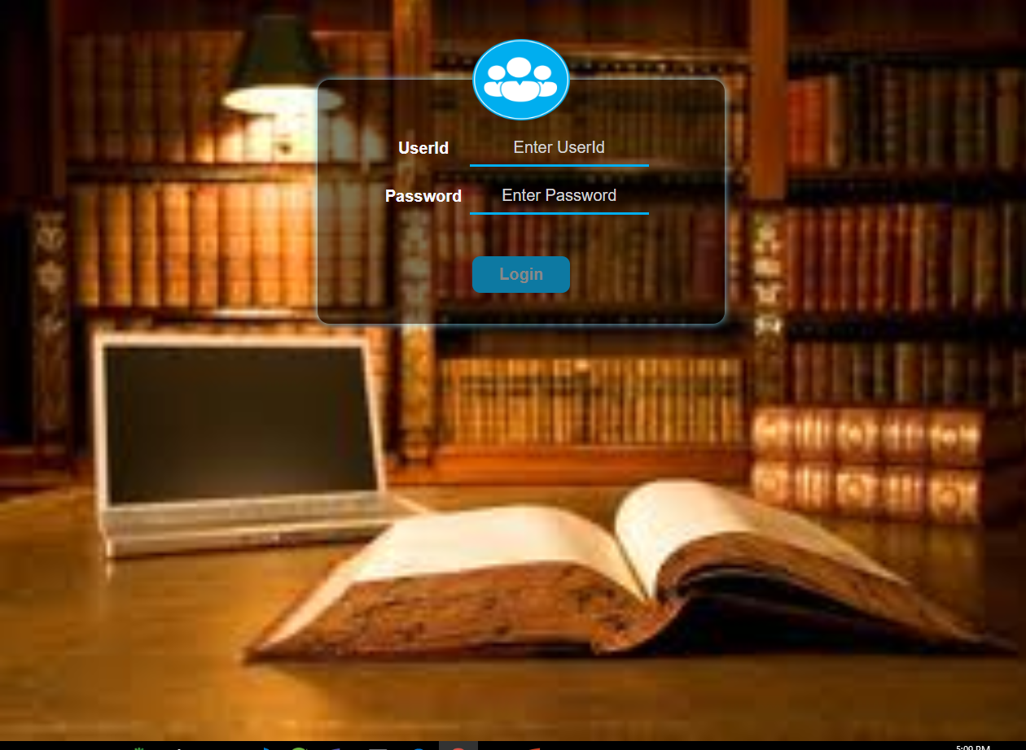
Login

Slide 6
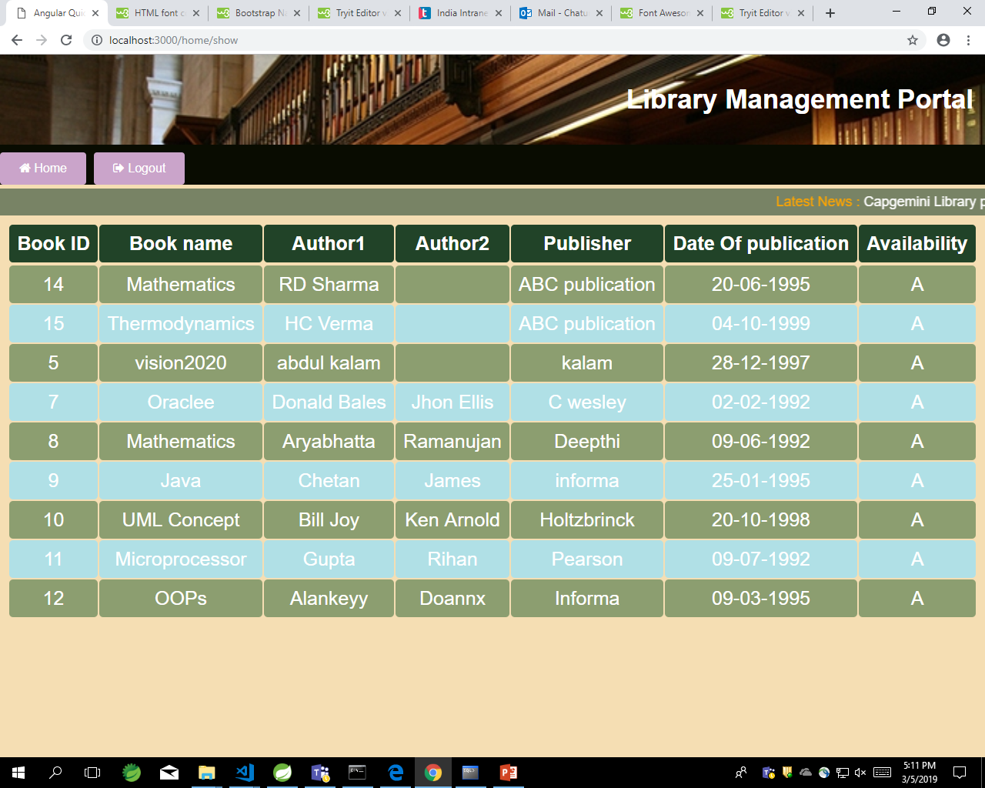
Home Page

Slide 7
Modules
Search Book Module:
This module can be used by a User.
Book is displayed as per the user’s input(if found).

Slide 8
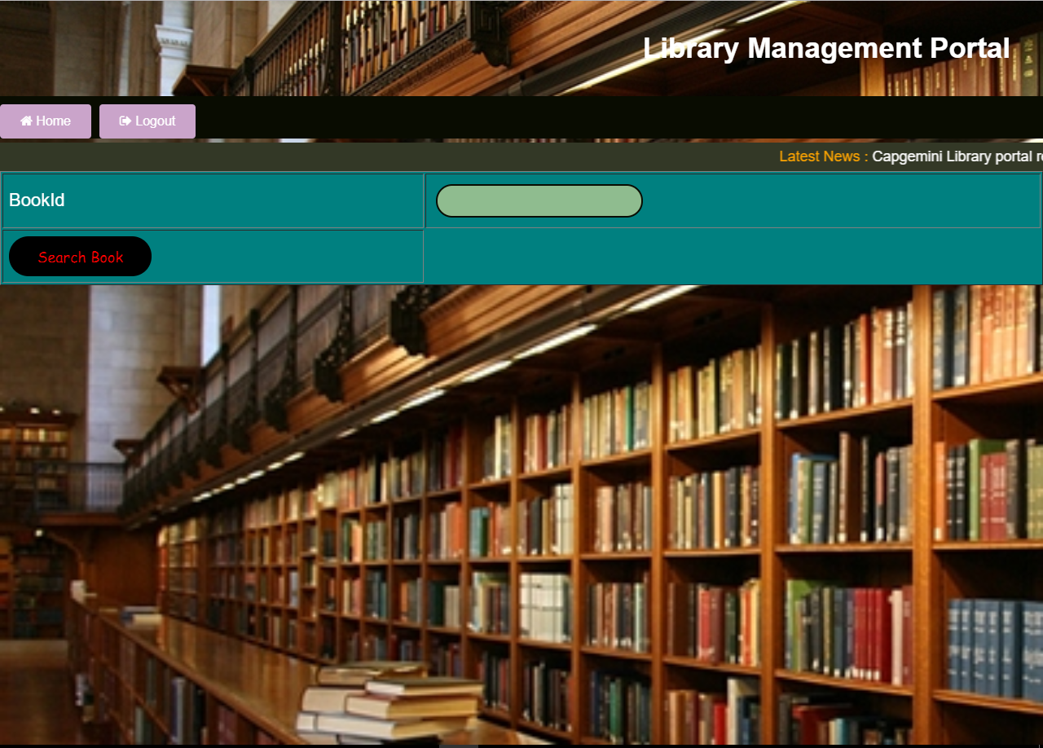
Search

Slide 9
Modules
Add Book:
User will add a new Book.
User will be asked to enter the following details:
Book Id
Book Name
Author1
Author2
Publisher
Year of publication
Check availability

Slide 10
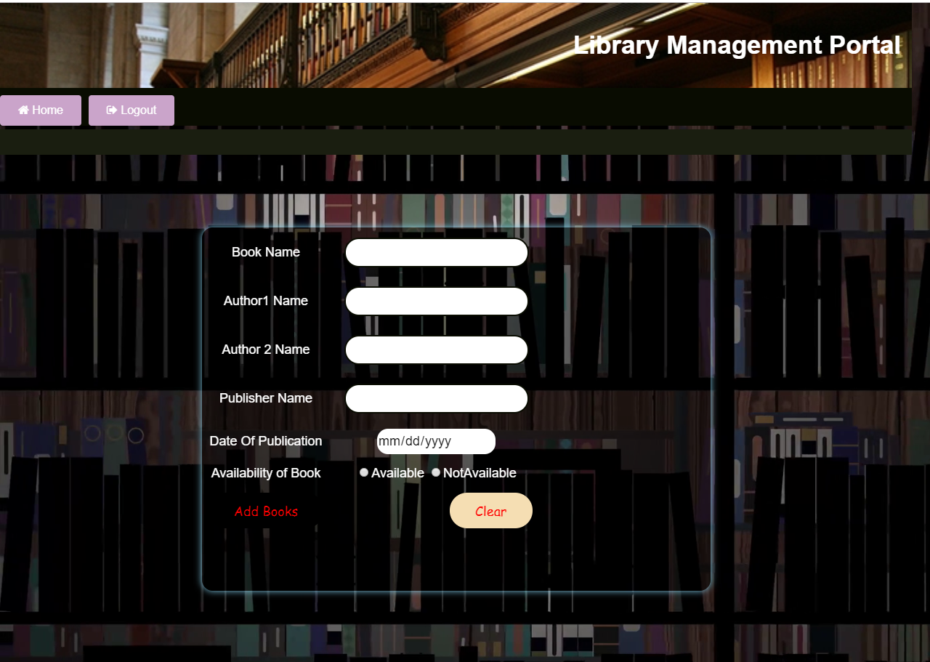
Add Book

Slide 11
Modules
Update Book:
Librarian will update an Books.
Librarian can update all the details mentioned in the add Book module

Slide 12
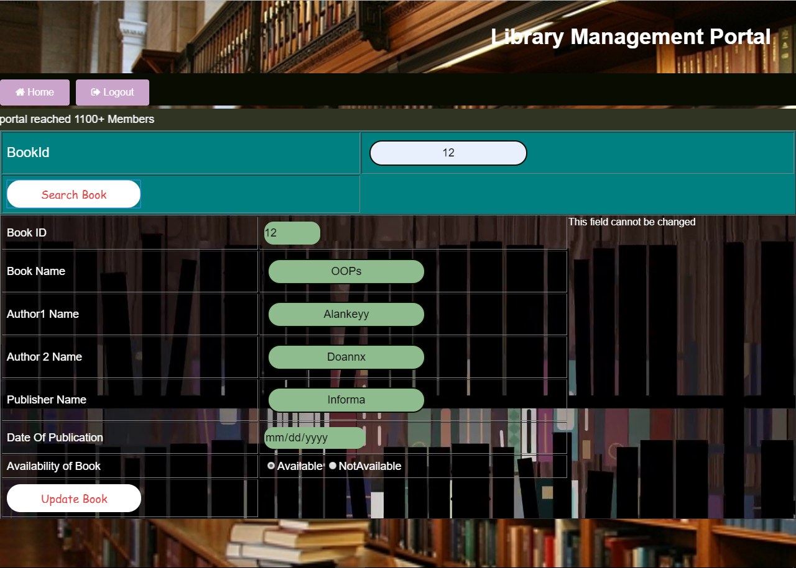
Update

Slide 13
Modules
Display Book Module:
Librarian will view the following reports:
Librarian will display the books.
Librarian displays the book, it is available or not available.

Slide 14
Display

Slide 15
Modules
Delete Book Module:
Librarian will view the following reports:
Librarian will delete the books.
Librarian will delete the book, when the user has taken the book from Library.

Slide 16
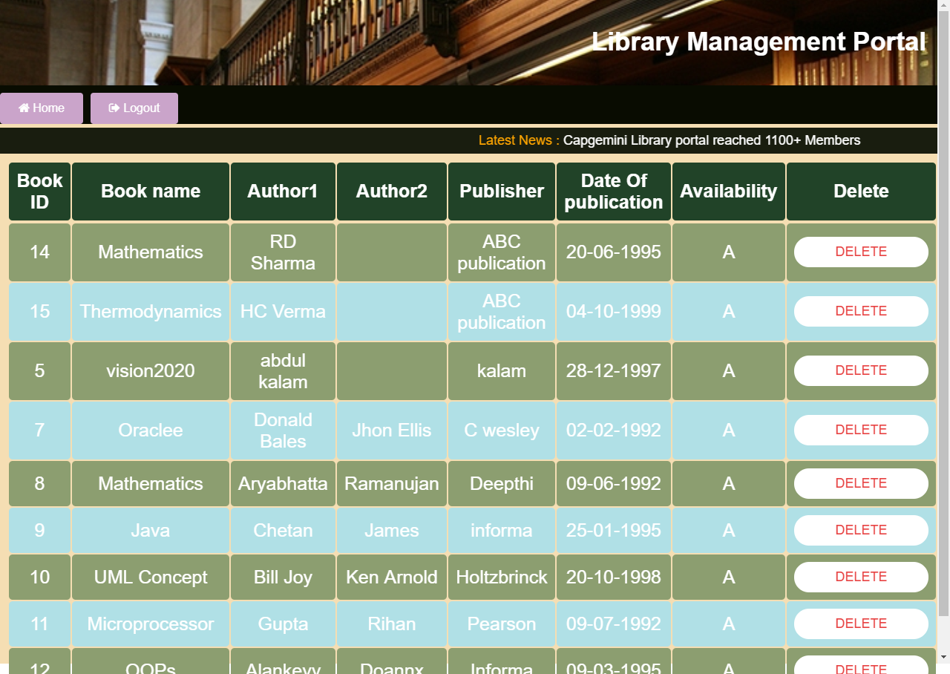
Delate

Slide 17
Modules
Added functionalities
Welcome message along with user’s name is displayed after successful login on the Homepage.
Change password functionality is provided.
Drop down Menu bar is provided on the Homepage to show the Books.

